Slide 1
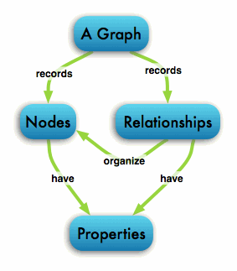
The Graph Database
Group 10: Srinath Sridhar & Shweta Anchan

Slide 2
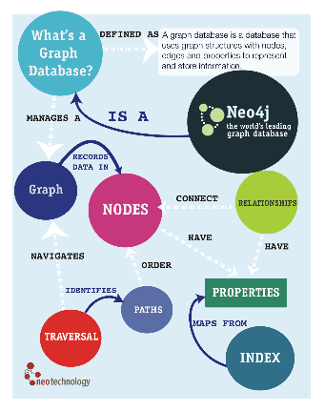
Agenda
What is Graph Database?
Pregel
Titan
Bagel
GraphX
Neo4j

Slide 3
What is a Graph Database?
Database that uses graph structures
Graph theory to store, map and query relationships
Data stored as nodes and relationships; nodes represent entities and edges represent relationships
Main interest is to use graph databases to mine data from social media, recommendation systems
Accessing relationships quickly; Other DBs compute relationships expensively
Independent of total size of dataset

Slide 4
Pros & Cons
Pros
Easy to express many kinds of data
Searches are quick and easy
Well suited to irregular, complex data
Accommodates new kinds of data
Cons
Large data operations slow
Uses a lot of space
Not widely used in business environments
Conceptually difficult to understand

Slide 5
Graph DB vs. Relational DB
Graph Database | Relational Database
Relationships stored at individual record level | Structure is defined at a higher level
Comparatively slow when operating on large number of records | Faster when operating on large number of records
Each record examined individually during query to know structure of data | Known ahead of time
Takes up more space | Less storage space since it does not have to store relationships

Slide 6
Pregel

Slide 7

What is Pregel?
Google’s internal graph processing platform
Applications that could perform internet-related graph algorithms
Scalable, general-purpose system for implementing graph algorithms in a distributed environment.
Targeted to large-scale graph problems
Based on Bulk Synchronous Parallel model of programming
Apache Giraph and CMU’s GraphLab; open source implementation of Pregel

Slide 8
How it works?
Master/Worker architecture
Uses message passing between vertices in a graph
Organized in a sequence of iterations called supersteps
Compute function run on each vertex
Messages are processed and sent to other vertices
Also, “Vote to halt”; deactivates vertex until it receives message. Job terminated.
Also,
Vertices and messages important; edges not central in Pregel
Messages sent if Vertex ID is known

Slide 9
Pregel on a cluster
Assign vertices to different machines and threads in the cluster
Done by using a hashing scheme; different approach like consistent hashing
Vertices on different machines pass messages between supersteps
Network overhead is small, if graph is relatively sparse and messages are small
Fault tolerance: Pregel uses checkpointing procedure

Slide 10
Uses & Advantages
Pregel can be used to solve a variety of problems:
Computing Page Rank
Finding shortest path in a graph
Finding clusters in social networks
It is useful for:
Ease of programming
Efficiency on graph problems

Slide 11
Titan

Slide 12

What is Titan
Aurelius developed Titan under liberal Apache 2 license
Scalable graph database optimized for storing & querying graphs containing huge data
Supports thousands of concurrent users accessing complex graphs in real time

Slide 13
Interacting with Titan
Query to create and access graph using Gremlin
Using Tinkerpop graph computing framework
Using Rexster and Blueprints API
Rexster is a graph server that exposes blueprints graphs through HTTP/REST
Blueprints is similar to JDBC

Slide 14
Features of Titan
Data distribution & replication for performance and fault tolerance
Supports storage backends like Cassandra, Hbase, Berkeley DB
Supports ElasticSearch, Solr & Lucene
They are open source softwares used for text search

Slide 15
Bagel

Slide 16
What is Bagel?
Spark implementation of Pregel
Supports basic graph computation, combiners & aggregators
Superseded by GraphX

Slide 17
GraphX

Slide 18
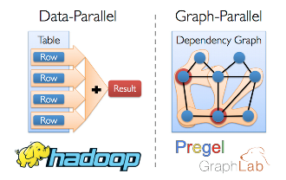
What is GraphX?
New Spark API for graphs and graph-parallel computation
Combines advantages of data-parallel and graph-parallel systems
Extends Spark RDD abstraction by introducing Resilient Distributed Property Graph
Simplifies graph construction and transformation
Growing collection of graph algorithms to simplify graph analytics
Currently available only in Scala

Slide 19

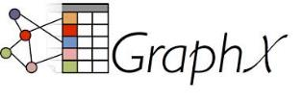
Usefulness of GraphX
Developers require access to both: graph libraries & traditional table data
Eg: Social graph as one input and product table ratings as other
Also, might want to take care of machine leaning algorithms
In comes GraphX and Spark which provides advantages of all functionality at once

Slide 20
Neo4J

Slide 21

What is Neo4J?
Open source graph database implemented in Java
Released in Feb 2010 under the GNU General Public License
Works with flexible network structure of nodes and relationship
Provides a web UI to interact with the tool

Slide 22
Working with Neo4J?
Maintains data in the form of Nodes, Relationships and Properties
Uses Cypher for writing and running graph queries
Does not stick to any schemas to maintain data
Nodes can have a mix of common and unique properties

Slide 23
Features of Neo4J?
Can export any query result in a tabular format
Produces result frames in a reverse chronological order
Can interact with different types of back ends
Provides metadata about query performance, data storage etc

Slide 24
Intro to Cypher
Neo4J’s graph query language
Just like SQL
Uses symbolic notations to describe the elements of the graph database
( ) – indicates nodes
{ } – indicates properties
[ ] – indicates relationship
Mostly used keywords – CREATE, MATCH, RETURN, DELETE

Slide 25
DEMO

